Slide 1





COVID-19 Detection using chest x-ray images
TEAM 3
aQdus Charolia
Affan Charolia
Bhagyashree Uttareshwar
Kalyani Nikure
Tuesday, November 30, 2021

Slide 2

Agenda
PROBLEM STATEMENT
OUR SOLUTION
ABOUT DATASET
METHODOLOGY
WEB APPLICATION
RESULTS
CONCLUSION
FUTURE WORK

Slide 3
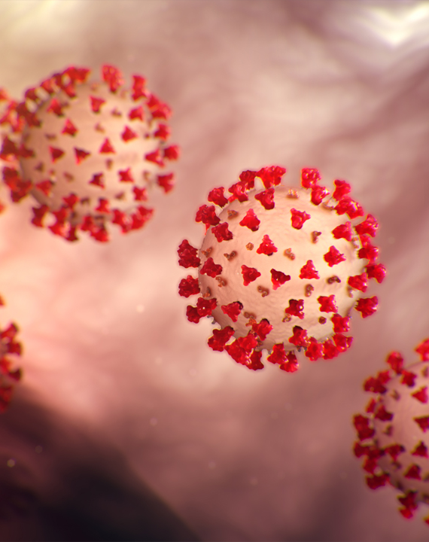
PROBLEM STATEMENT
COVID-19 PANDEMIC
A total of 48 million people COVID-19 cases have been reported in USA.
About 65 million people suffer from lung diseases and 3 million die from it each year.
People are more reluctant to stay at home and getting to know their X-ray results if they suffer from any lung diseases.

Slide 4



OUR SOLUTION
Let’s solve it together
Presented a Web based application where X-ray images can be uploaded to get the closest prediction between 4 different classes
Classes - COVID-19, Lung Opacity, Normal, Viral Pneumonia
The application is designed to be used by medical professionals for a quick result.

Slide 5

ABOUT DATASET
COVID-19 Radiography Database
The University of Dhaka, Bangladesh, Qatar University, and their collaborators from Pakistan and Malaysia, in collaboration with doctors, have created a database of chest X-ray images
Total of 21,164 images available on Kaggle
The dataset contains 3615 COVID-19, 10192 Normal, 6012 Lung opacity, and 1345 Viral Pneumonia images
The images are collected from different sources

Slide 6
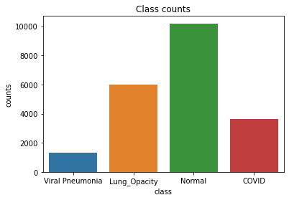
images by category

Slide 7
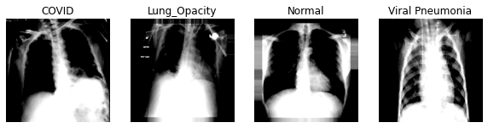
Data Pre-Processing
Used Tensorflow’s ImageDataGenerator library.
Images are augmented by changing the zoom range to 0.2
Performed sample-wise-standard-normalization and performed a rescale of 1./255 for each image followed by a validation split of 20% on the dataset
No data augmentation was performed for Validation data
The batch size of the training and validation data was set to 32
Pre-processed 16933 images for the training data and 4232 images for the validation data

Slide 8

NEXT STEPS
TRAINING PHASE

Slide 9
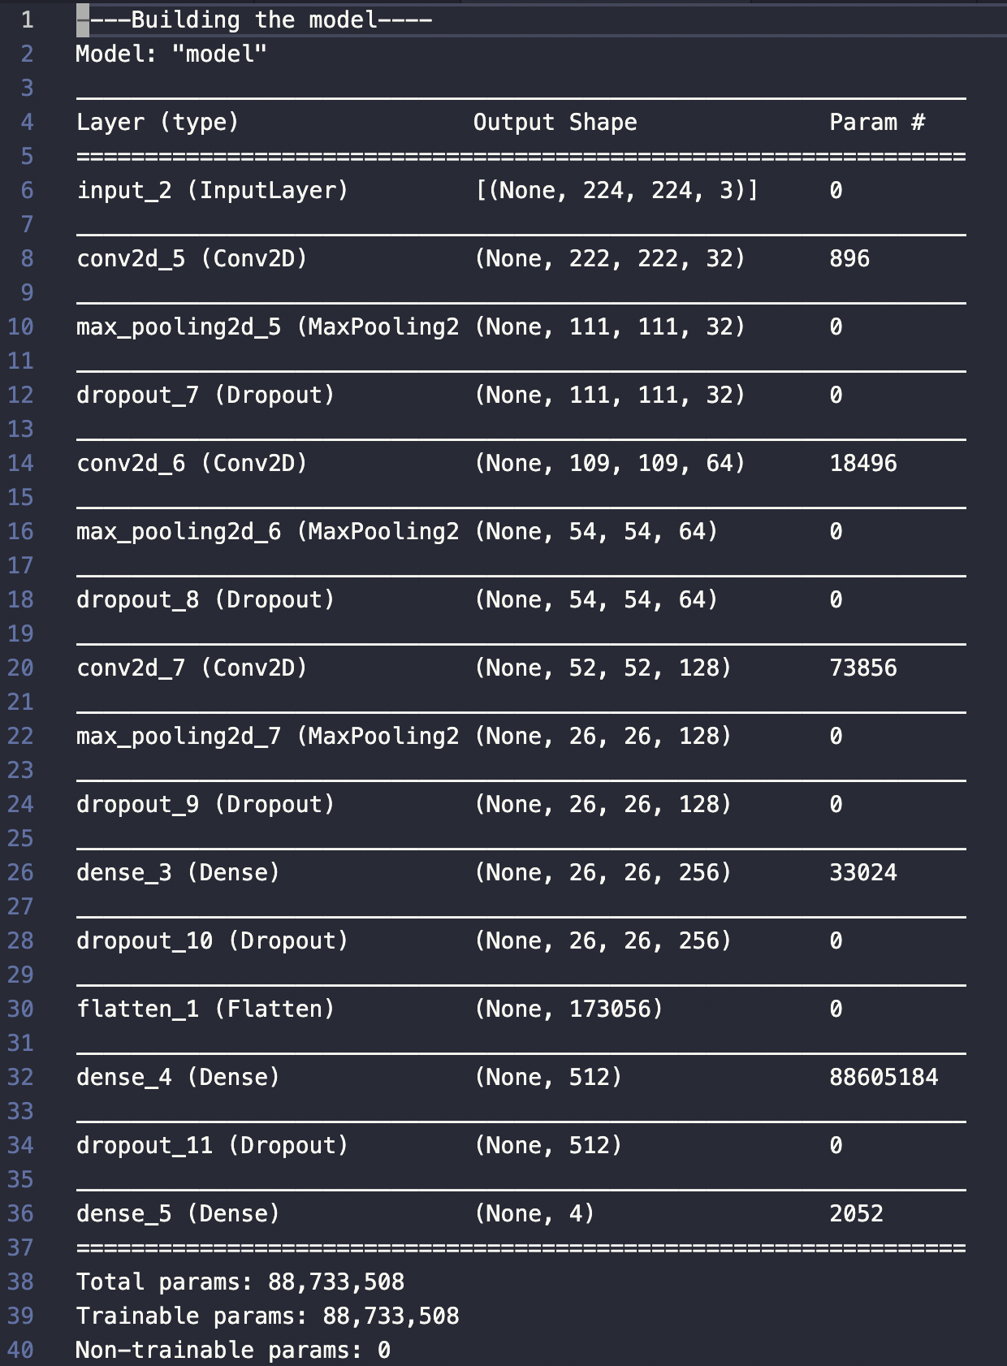
CNN
MODEL SUMMARY
A custom Convolutional Neural Network
Dense layers starting from 16 layers to 256 layers Followed by dropout layers
Batch normalization layers to avoid overfitting
A total of 88,733,508 params were trained

Slide 10
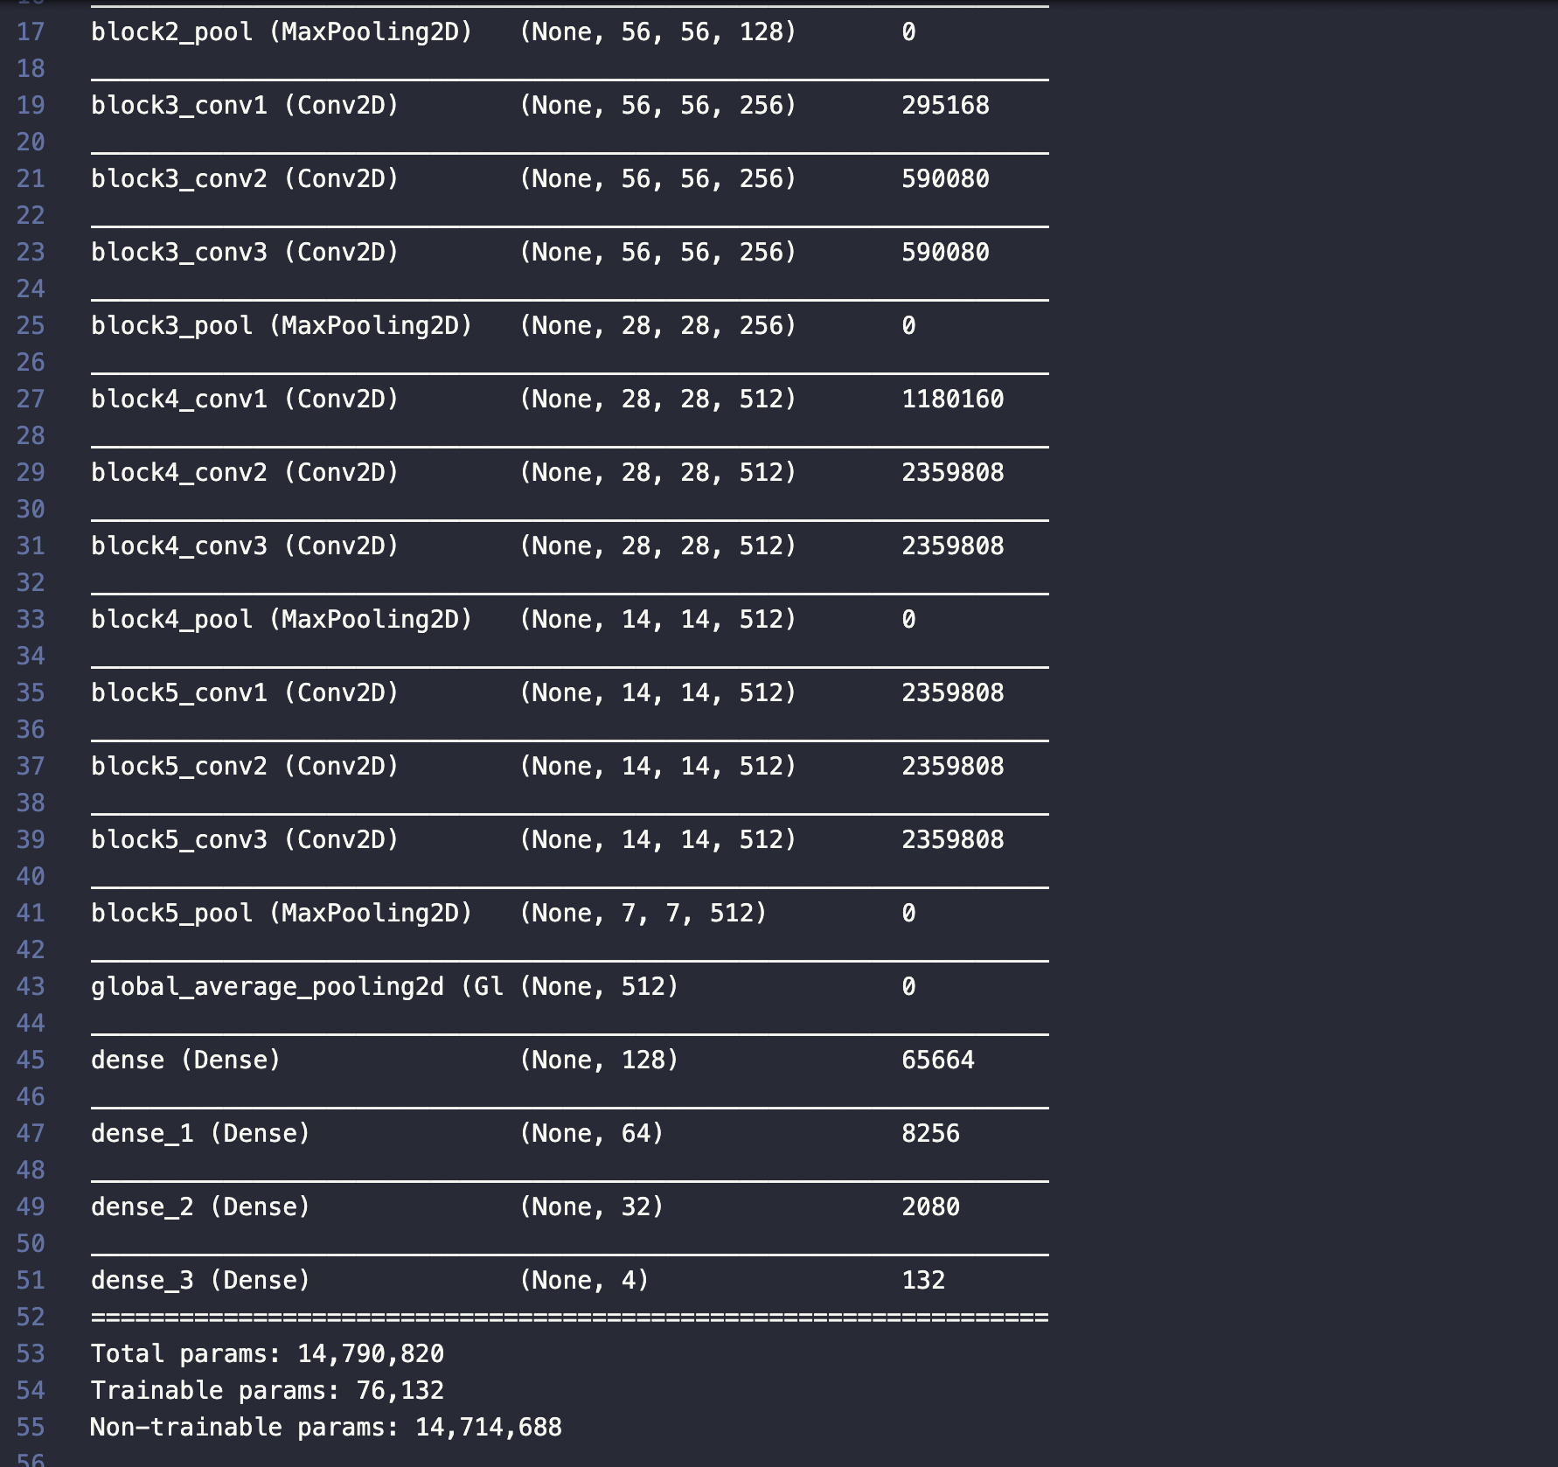
VGG16
MODEL SUMMARY
The model achieves 92.7% top-5 test accuracy in ImageNet
ImageNet dataset of over 14 million images belonging to 1000 classes
It has multiple 3×3 kernel-sized filters one after another
Addition of 2-3 layers after Global Average Pooling layers and the output layer

Slide 11
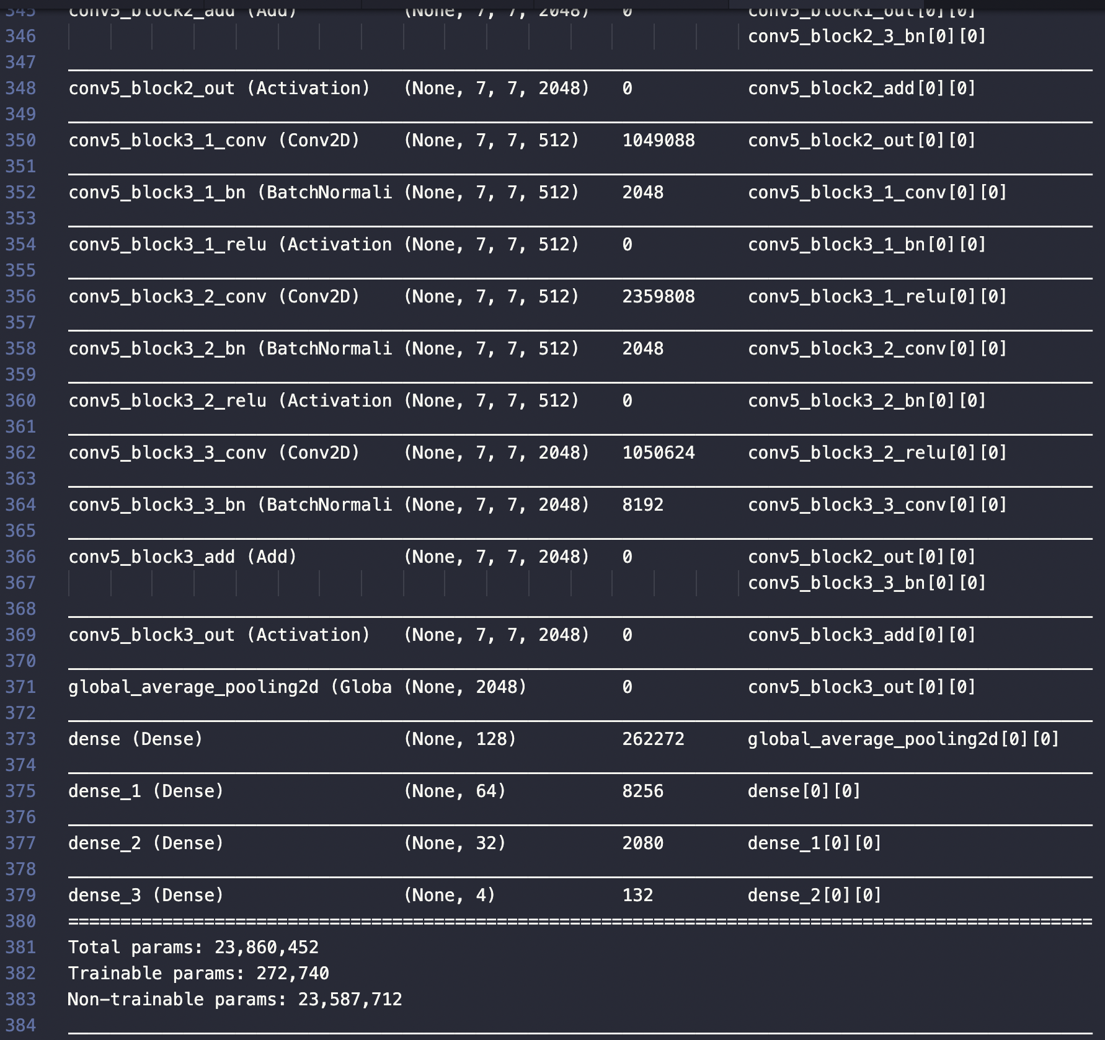
RESNET50
Model summary
Deep residual network - ResNet-50
Convolutional neural network (CNN) which is 50 layers deep
Powerful backbone model that is used very frequently in many computer vision tasks
Uses a skip connection to add the output from an earlier layer to a later layer
Helps mitigate the vanishing gradient problem

Slide 12
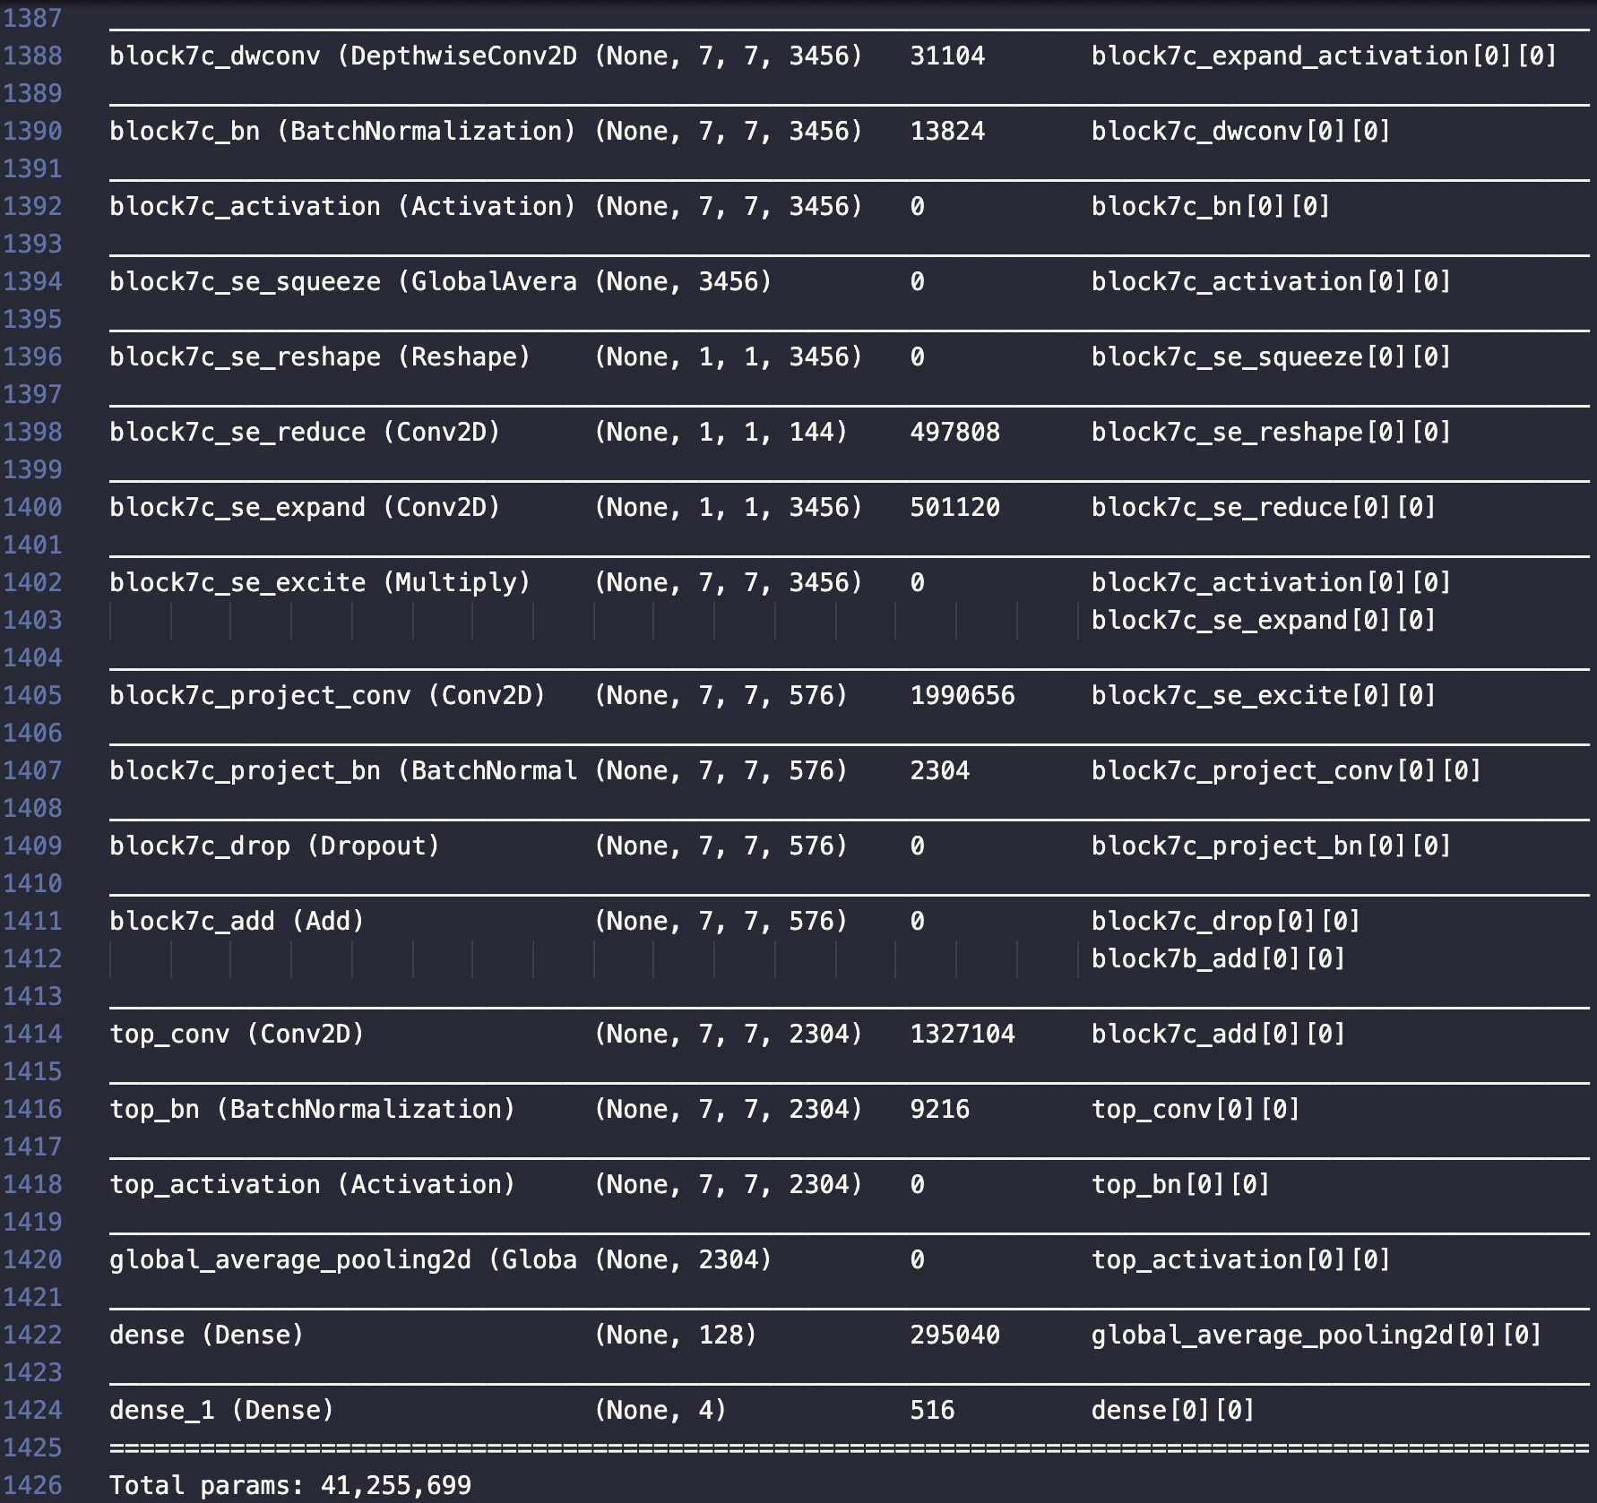
EFFicientnetb6
Model summary
Convolutional neural network architecture with a scaling method
Uniformly scales all dimensions of depth/width/resolution using a compound coefficient.
Unlike conventional practice that arbitrary scales these factors, the EfficientNet scaling method uniformly scales network width, depth, and resolution with a set of fixed scaling coefficients

Slide 13

Results from MODELS
Let’s Dive In

Slide 14
MODEL performance
Characteristics | CNN | VGG16 | ReNet50 | EfficientNetB6
Timeframe | 53.51 Minutes | 87.6 Minutes | 50.1 Minutes | 153.2 Minutes
Training Accuracy | 90.70% | 89.36% | 80.38% | 48.15%
Training Loss | 24.98% | 28.21% | 49.15% | 116.1%
Validation Accuracy | 89.70% | 88.28% | 83.36% | 48.16%
Validation Loss | 28.59% | 33.62% | 44.52% | 116.24%

Slide 15
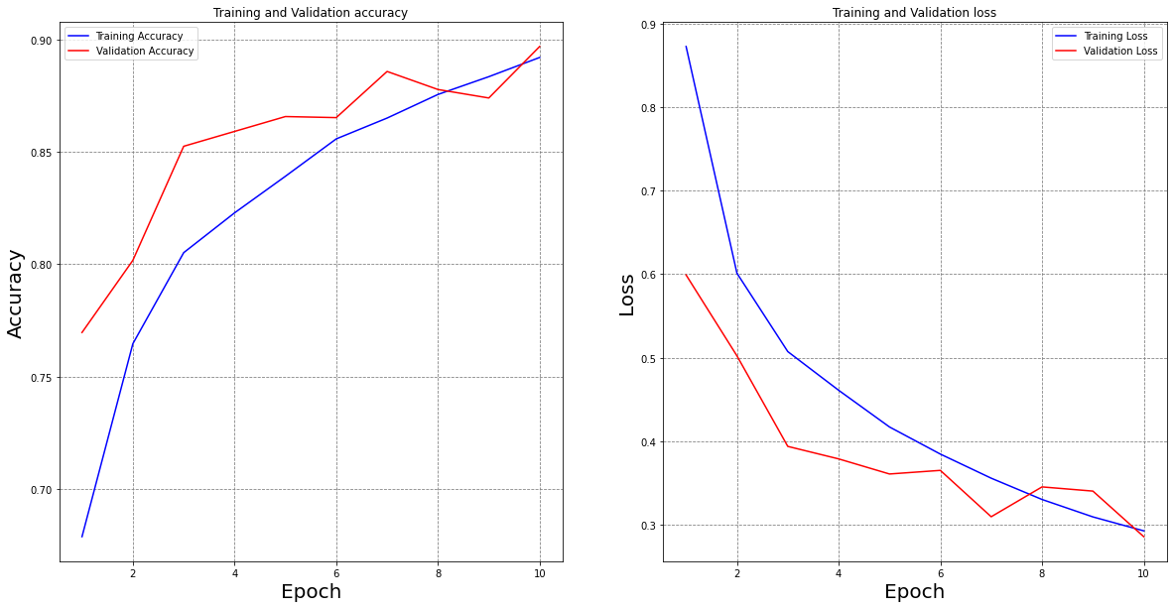
CNN
MODEL ACCURACY AND LOSS PLOT

Slide 16
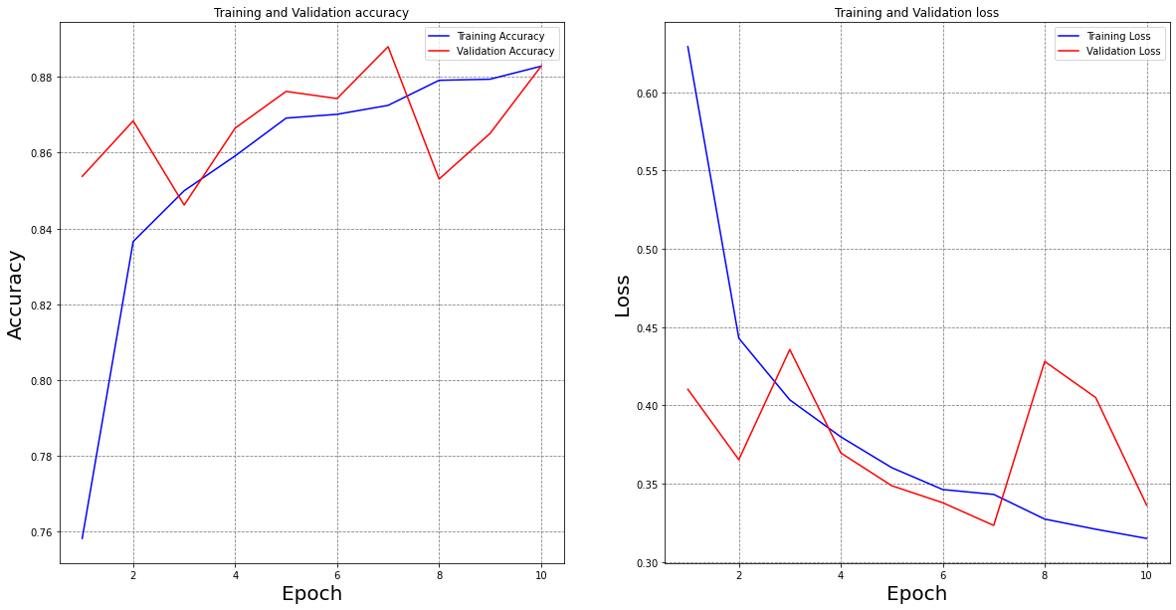
VGG16
MODEL ACCURACY AND LOSS PLOT

Slide 17

What’s next
WEB APPLICATION

Slide 18
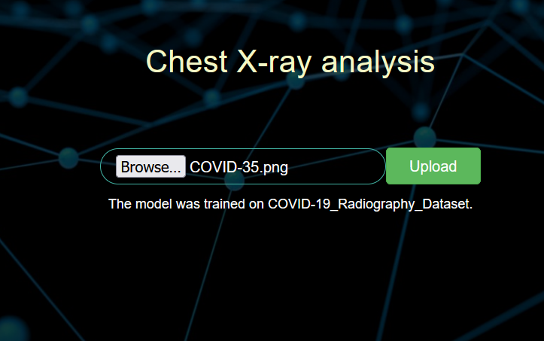
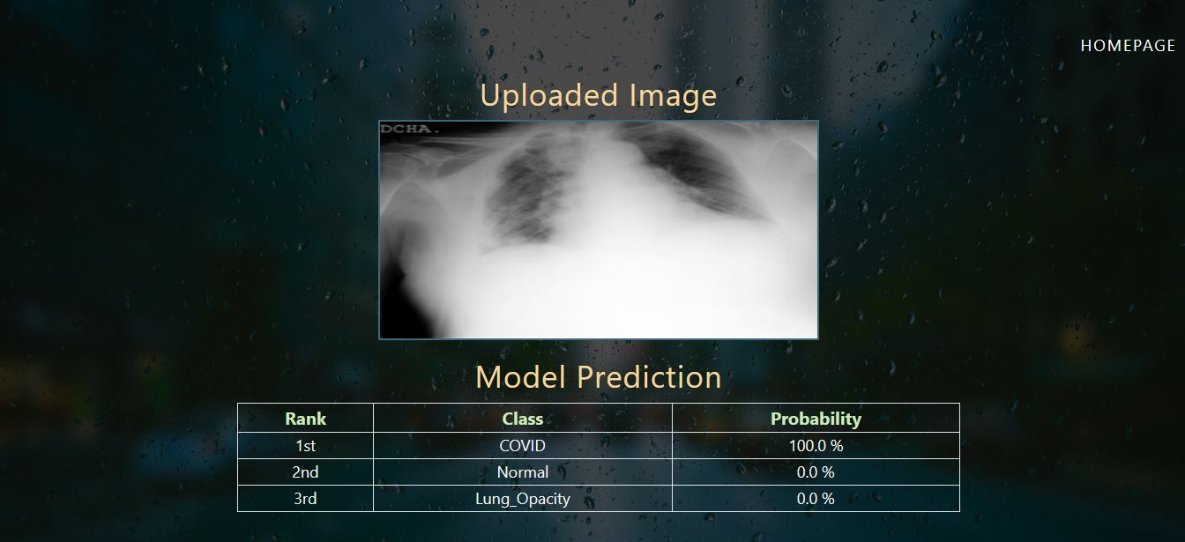
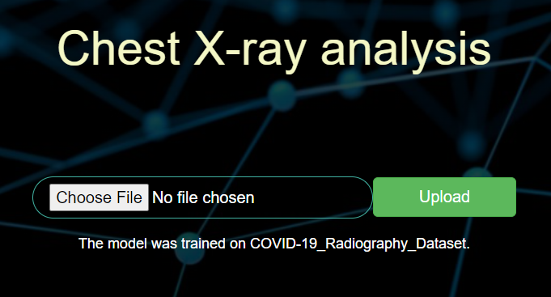


WEB APPLICATION AT A GLANCE
HOME PAGE
Click on Choose File Button to select an image file
Link: website
Click on Upload button to start processing
UPLOADED IMAGE
Preview of Covid X-ray Image upload
MODEL PREDICTION
This presents the predicted class with its respective probability
Model predicted 100% accurately

Slide 19
Covid image prediction

Slide 20
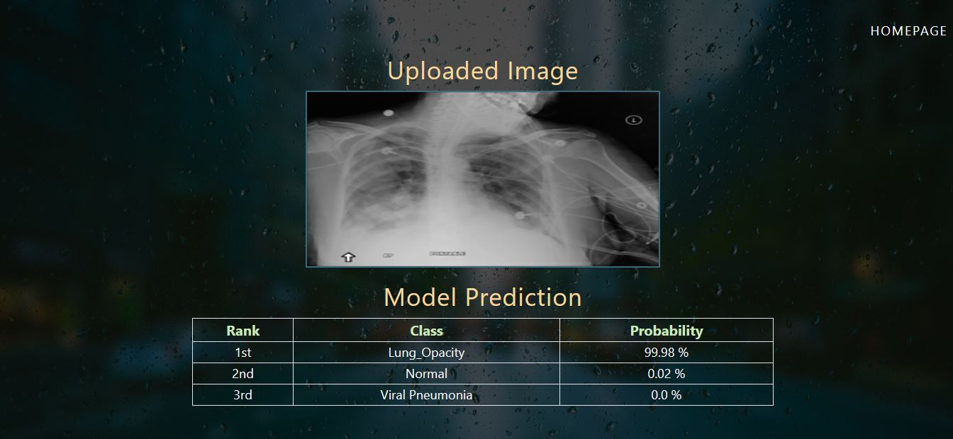
Lung opacity image prediction

Slide 21
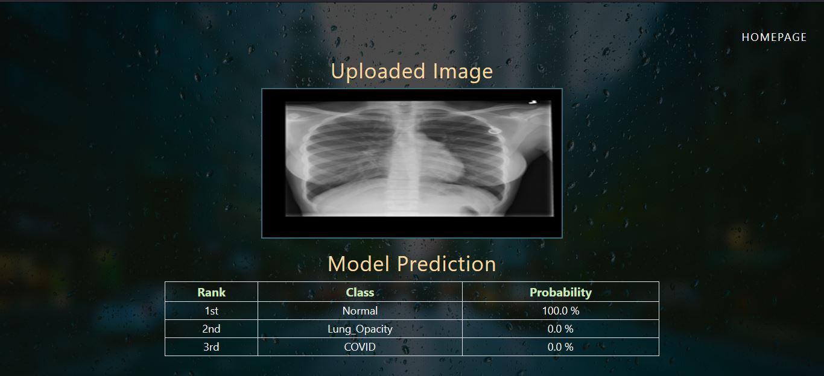
Normal image prediction

Slide 22
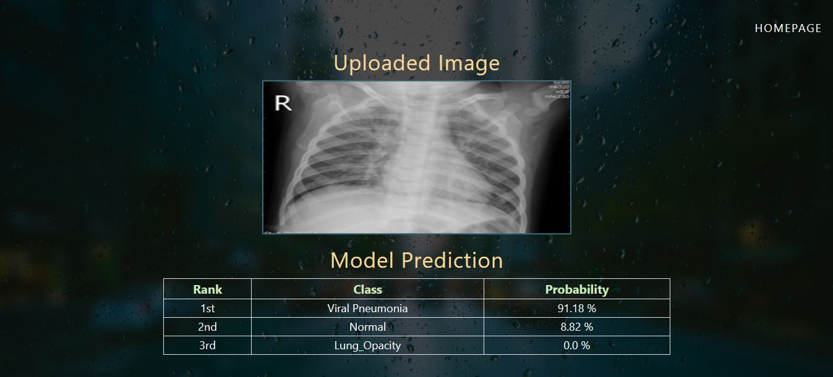
Viral pneumonia image prediction

Slide 23

CONCLUSION
Accuracy of 89% is achieved using VGG16 and CNN model
Deep neural network model performed well in classifying COVID-19, healthy, lung opacity, and viral pneumonia CXR images—especially the VGG16 and CNN networks, which surpassed other networks in all metrics.
This Photo by Unknown Author is licensed under CC BY-SA

Slide 24

Questions
WE APPRECIATE FEEDBACK

Slide 25


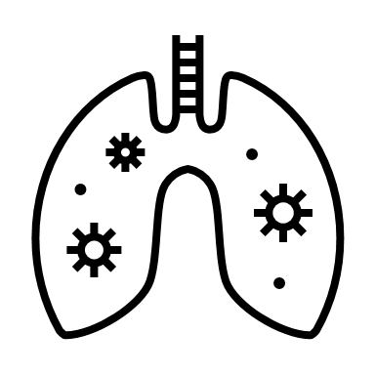
THANK YOU!
STAY SAFE AND HEALTHY
TEAM 3

